Slide 1
Workflows and Approvals
December 2013

Slide 2
Basics of Workflows
What is a workflow?
  A set of rules that trigger workflow actions into motion when their designated conditions are met
  Click Setup ➤ Create ➤Workflow & Approvals ➤Workflow Rules
Why use workflow ?
  To automate your organization’s standard processes
Types of Workflows Actions
  Email Alerts
  Workflow Tasks
  Field Updates
  Outbound Messages
  Time Dependent Workflow

Slide 3
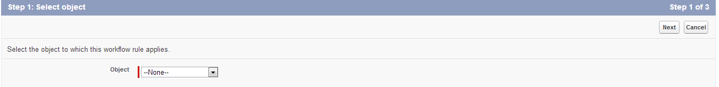
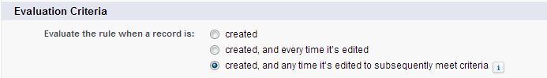
Components of Workflows
Each workflow rule consists of :
Object Type :
  The object to which this workflow rule applies
Evaluation Criteria :
  Only when a record is created
  Created and every time a record is edited
  When a record is created, and when a record is edited and did not previously meet the rule criteria
Notes:
Evaluation Criteria: What are the instances when the rule should evaluate the entry criteria and fire the Workflow.

Slide 4
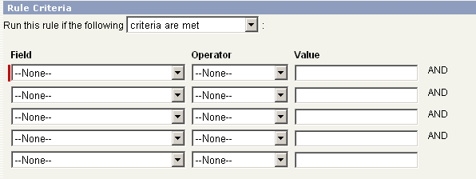
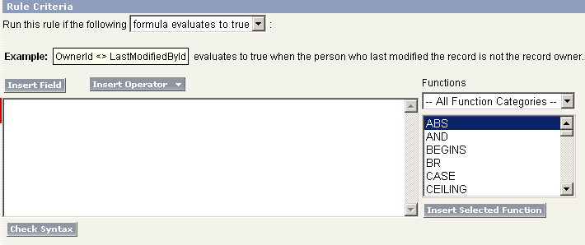
Components of Workflows cont…
Rule Criteria :
  Criteria that determine when Salesforce executes the workflow rule
  Any change that causes a record to match this criteria can trigger the workflow rule, even changes to hidden fields
Notes:
Rule Criteria: What is the Actual Business logic in place, and how can it be mapped in terms of fields and logical conditions.

Slide 5
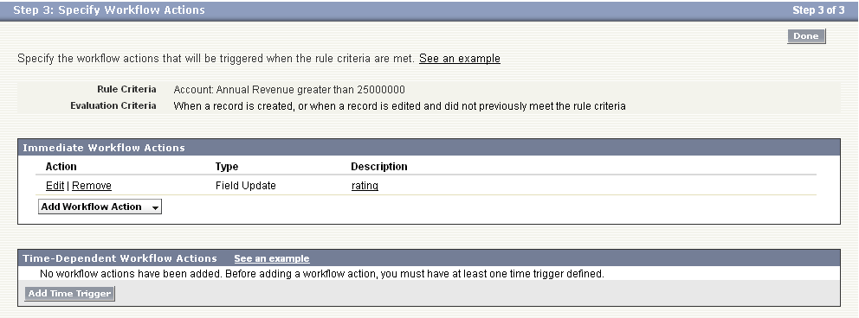
Components of Workflows cont…
Workflow Action:
  Immediate actions to take when a record matches the criteria.
Time-dependent Actions:
  Time-dependent actions that Salesforce queues when a record matches the criteria and executes according to your time triggers

Slide 6
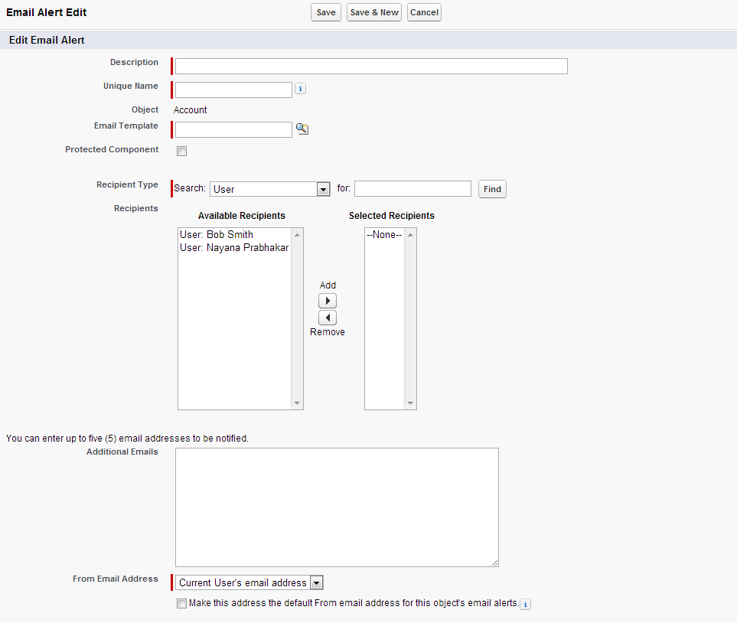
Email Alerts
When Rule Criteria is met, sends an email to one or more recipients you specify
You cannot create email alerts for workflow rules that apply to activities
Example – Send Email to Opportunity Owner after 10 days stating the Opportunity is still not closed

Slide 7
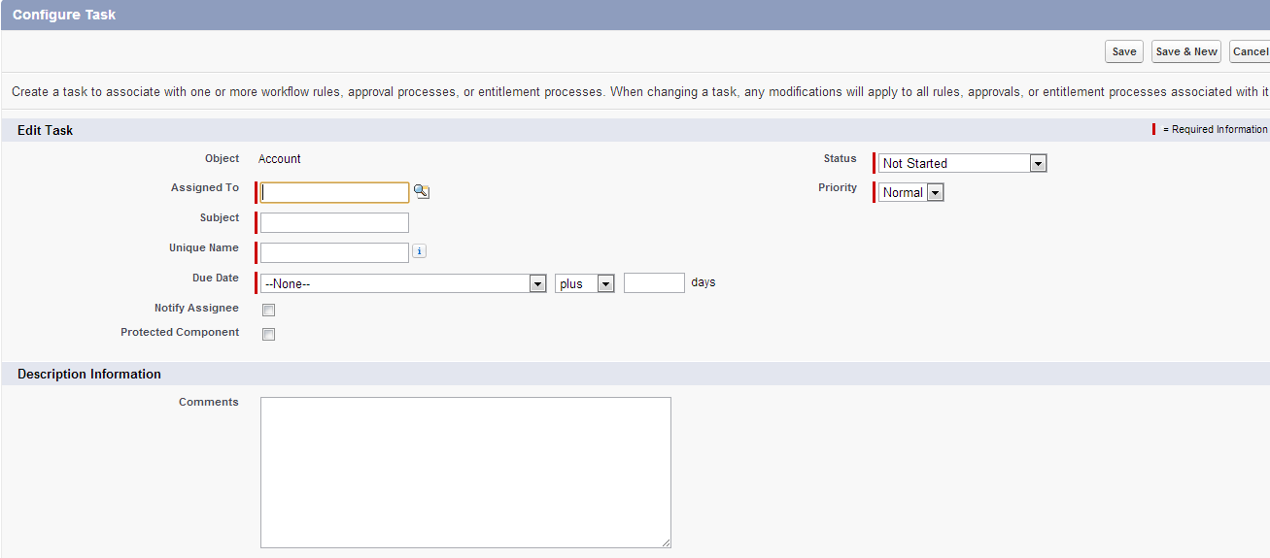
Tasks Workflows
Containing the information a workflow rule uses to assign a task to specified users whenever specific business actions trigger the rule
Workflow tasks provide the Subject, Status, Priority, and Due Date for the tasks a workflow rule or approval process assigns
Example – Create a task when a Lead is created with subject : Capture lead and due date of one month from lead creation date

Slide 8
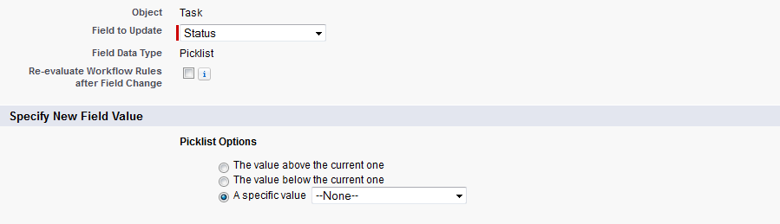
Field Updates Workflows
Specify the field you want updated and the new value for it
Depending on the type of field, you can choose to apply a specific value, make the value blank, or calculate a value based on a formula you create
You can enable all the work flows to be re-evaluated as a result of that field update
Example – Depending upon the value of Annual Revenue of Account display the rating of the Account
  Revenue less than $10,00,000 → Rating Cold
  Revenue less than $50,00,000 → Rating Warm
  Revenue less than $100,00,000 → Rating Hot

Slide 9
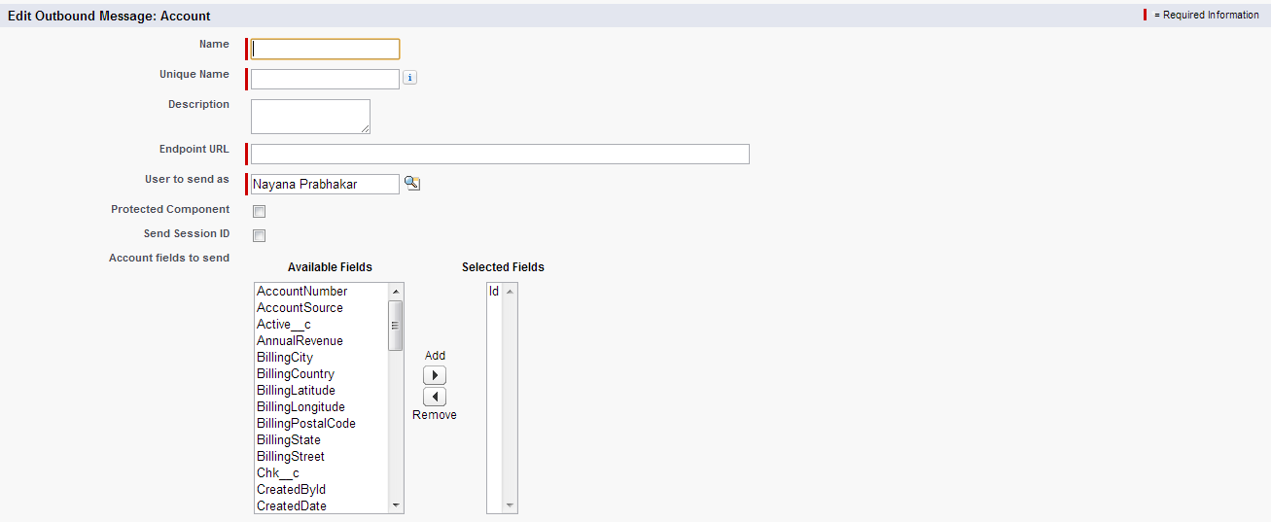
Outbound Messages Workflows
Send the information you specify to an endpoint you designate, such as an external service
An outbound message sends the data in the specified fields in the form of a SOAP message to the endpoint
Example - Automatically initiate the reimbursement process for an approved expense report by triggering an outbound API message to an external HR system
Notes:
Informatica Cloud Outbound Message: http://www.youtube.com/watch?v=HNoaqooOEFc
Salesforce Outbound Messaging: http://www.salesforce.com/us/developer/docs/api/Content/sforce_api_om_outboundmessaging.htm
http://www.salesforce.com/us/developer/docs/api/Content/sforce_api_om_outboundmessaging_setting_up.htm

Slide 10
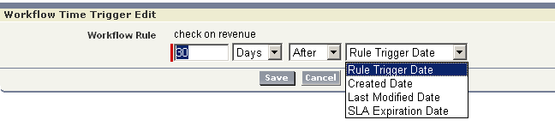
Time Dependent Workflows
Gives us the ability to -
  Execute time specification
  Use the workflow queue to manage all pending actions
Select a Default Workflow User that you want Salesforce to display with a workflow rule when the user that triggered the rule is not active
Time-dependent workflow actions are not applied to a workflow rule if the workflow rule evaluation criteria is set to Every time a record is created or updated
If the workflow rule criteria contains a date field, and you update the date field on a record to which that rule applies, Salesforce recalculates the unfired time triggers associated with the rule
If a workflow rule has a time trigger set for a time in the past, Salesforce queues the associated time-dependent actions to execute sometime within the hour, depending on system usage

Slide 11
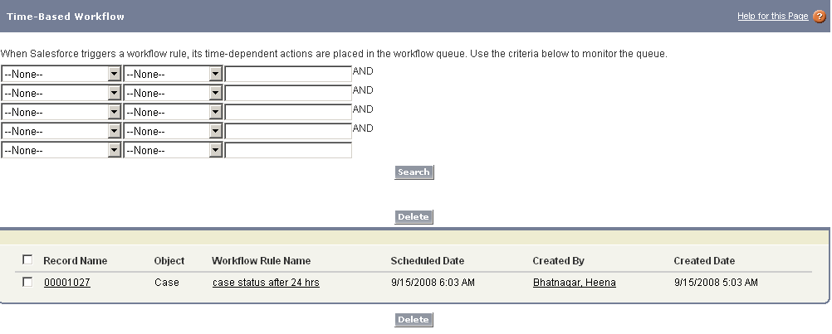
Monitoring the Workflow Queue
When Salesforce triggers a workflow rule that has time-dependent actions, use the workflow queue to view pending actions and cancel them if necessary
Time-dependent actions remain in the workflow queue only as long as the rule criteria for the workflow rule is still valid. If a record no longer matches the rule criteria, Salesforce removes the time-dependent actions queued for that record

Slide 12
Facts on Workflows
Each workflow rule applies to a single object, such as leads, accounts, or opportunities.
Workflow rules can only trigger workflow actions that are relevant to the object to which the workflow rule applies. For example, if a workflow rule applies to accounts, it can only trigger field updates that affect fields on account records.
Workflow rules cannot be triggered by campaign statistic fields, including individual campaign statistics and campaign hierarchy statistics.
Workflow rules can be triggered any time a record is saved or created, depending on your rule criteria. However, rules created after saving records are not triggered by those records retroactively
Workflow rules only trigger on converted leads if “validation and triggers for lead convert “ are enabled in your organization.
Workflow rules on custom objects are automatically deleted if the custom object is deleted
Workflow rules trigger automatically and are invisible to the user.
Saving or creating records can trigger more than one rule.
Any changes you make to records while using Connect Offline will be evaluated by workflow rules when you synchronize.
If a lookup field references a record that is deleted, Salesforce sets the lookup field to null, and does not run any Apex triggers, validation rules, workflow rules, or roll-up summary fields.
The System Log console lets you view both historic and real-time workflow rule information, such as the name of the user who triggered the workflow rule and the name and ID of the record being evaluated.
You can deactivate a workflow rule at any time. If the rule has pending actions in the workflow queue, editing the record that triggered the rule removes the pending actions from the queue. If you do not edit the record, the pending actions are processed even though the rule has been deactivated.

Slide 13
Exceptions for Workflow Rules
The following will not trigger workflow rules:
  Mass replacing Picklist values
  Mass updating address fields
  Changing the territory assignments of accounts and opportunities
  Converting leads to person accounts

Slide 14
Execution order of Workflows
Salesforce processes any rules in the following order:
  Validation rules
  Assignment rules
  Auto-response rules
  Workflow rules (with immediate actions)
  Escalation rules

Slide 15
What is Approval Process?
An approval process is sanctioning, that an organization can use to run the business process in adherence to policies which in turn provides benefits to the stakeholders involved
A typical business requires processes that undergoes various approval phases which provides benefits for the stakeholders involved without having impact on business. Stakeholders may include employer, investor, employee, customers, etc
Approval Process – Salesforce:
An approval process is an automated process that an organization can use to approve records in Salesforce
Approval Processes specify the steps necessary for a record to be approved and who must approve it at each step
An approval process also specifies the workflow actions to take when a record is approved, rejected, or first submitted for approval

Slide 16
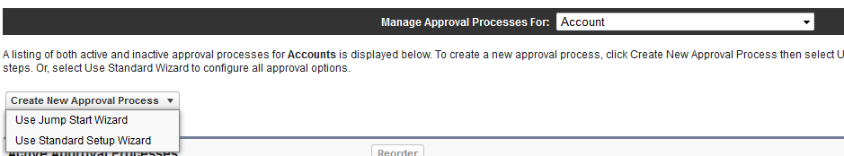
Approval Process Wizard
Click Setup | Create | Workflow & Approvals | Approval Processes.
Choose the object for the new approval process
Click Create New Approval Process
Choose
  Use Standard Setup Wizard from the drop-down button
  Use Jump Start Wizard – (basic approval process with default settings)

Slide 17
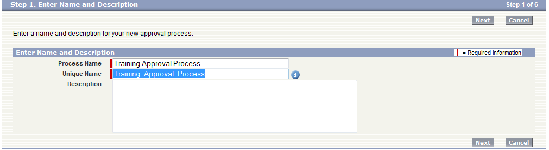
Approval Process Wizard – Step 1
Enter Name and Description
Enter a Process Name, Unique Name for the new approval process
Optionally, enter a Description for approval process

Slide 18
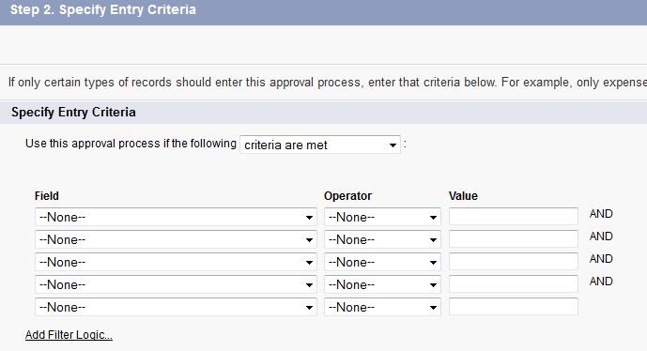
Approval Process Wizard – Step 2
Specify Entry Criteria
Specify criteria that a record must meet to enter this approval process
  For example, if only employees from headquarters should use this approval process to submit expense reports, enter the following filter criteria: “Current User: Office Location Equals Headquarters”
Select formula evaluates to true if you want a formula to determine what records enter the approval process

Slide 19
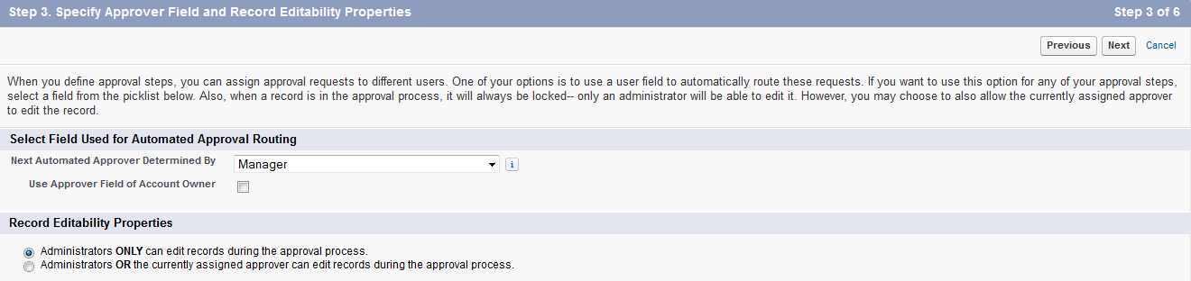
Approval Process Wizard – Step 3
Specify Approver Field and Record Editability Properties
Salesforce.com automates the approval routing by providing option ‘Next Automated Approver Determined By’ – (User picklist field )
  For eg: if Manager is selected, the approval will be routed to requestor’s (User) Manager specified in requestor’s detail page
  Restriction can be enforced to route the approval to record owner’s associated user
Two record editability properties available:
  Administrator only can edit records during approval process
  Administrator or currently assigned approver can edit records during approval process

Slide 20
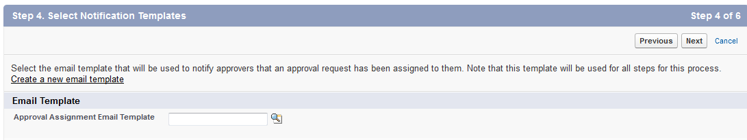
Approval Process Wizard – Step 4
Select Email Notification Template
Salesforce.com automatically notifies the approver when a record is submitted for approval
Choose a custom email template to use when notifying approvers or leave this field blank to use the default email template
If email approval response is enabled, be sure the email template you use describes how to correctly use both response options: clicking the link and replying by email
Approval merge fields in email template will return values only if it was used as approval assignment template

Slide 21
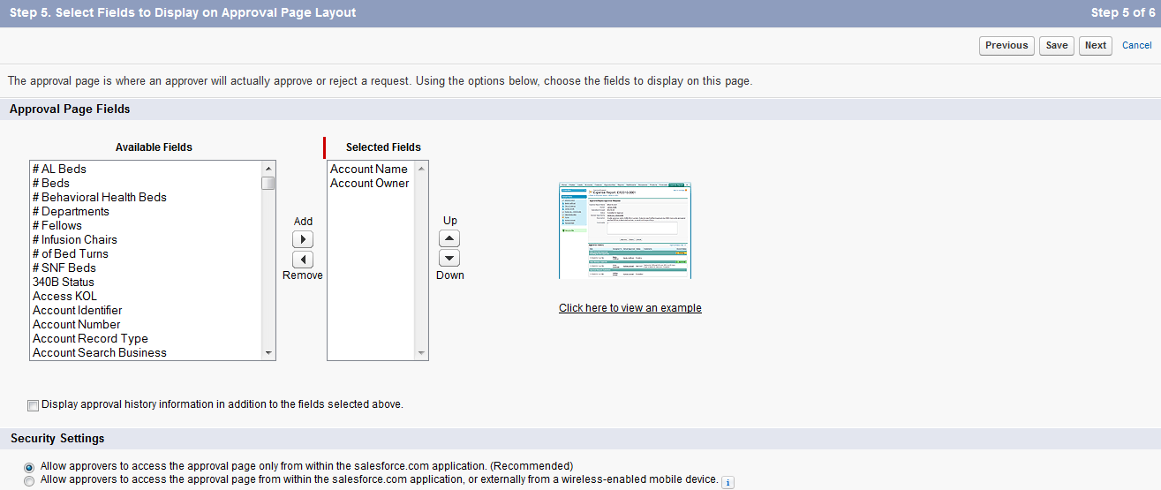
Approval Process Wizard – Step 5
Select Fields to Display on Approval Page Layout

Slide 22
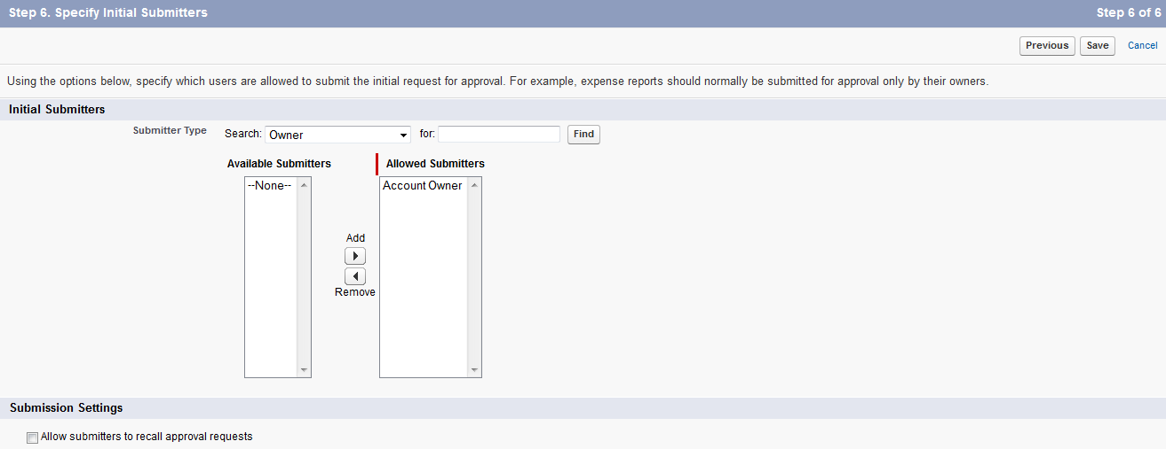
Approval Process Wizard – Step 6
Specify Initial Submitters

Slide 23
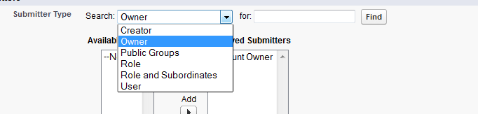
Approval Process Wizard – Step 6
Specify Initial Submitters
The initial submitters can be chosen from Categories:
Creator
Owner
Public Groups
Role
Role and Subordinates
Users

Slide 24
Approval Process Wizard – Final Step
Actions and Steps
You can associate approval actions with :-
Initial submission actions
Final Approval Actions
Final Rejection Actions
Recall Actions
Approval Steps
There are four types of approval actions
Task
Email
Field Update
Outbound

Slide 25
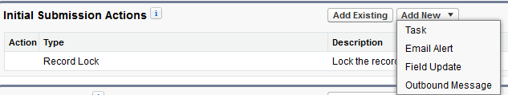
Approval Process Field Update
Setting up a Field Update
On all the above Approval Steps one could define the Approval Steps
Below is an example of Setting a Field Update.
Step 1: Click on “Add New” and choose “Field Update”

Slide 26
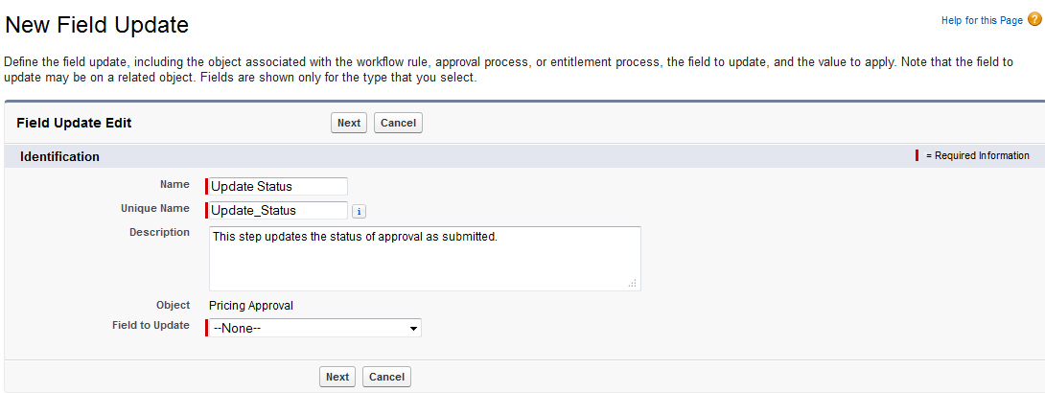
Approval Process Field Update
Setting up a Field Update
Step 2: Fill in the unique Field Update Name related to the Current Approval Process
Select the Field to update
  Displays additional data based on the field type

Slide 27
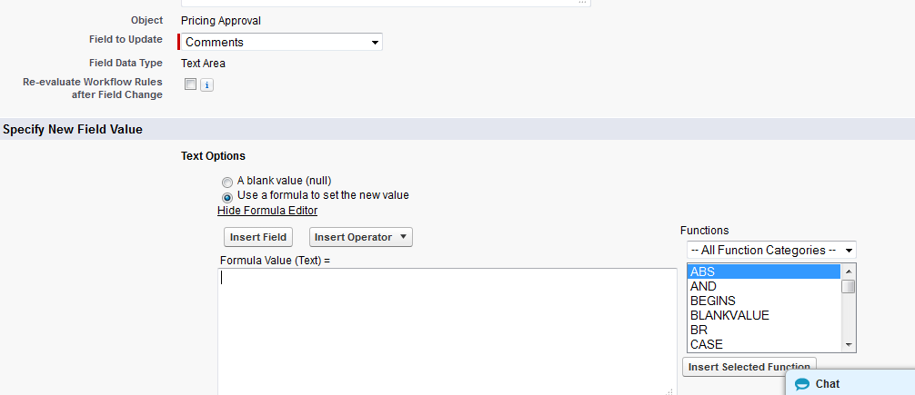
Approval Process Field Update
Behavior for Text Fields
Following is the options enabled for a Text Field Update Selection
Once the field which is under consideration for updating is selected additional data is displayed based on the Field Type
Formula Editor is available to define logic or calculations

Slide 28
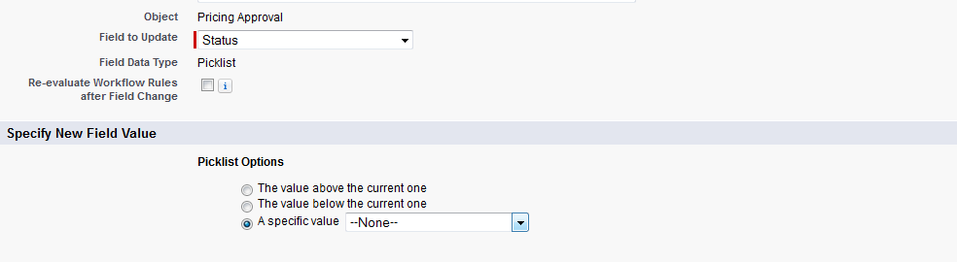
Approval Process Field Update
Behavior for Pick list Fields
Following is the options enabled for a Pick list Field Update Selection
Provision to choose a specific Value from the pick list is rendered
Once the Field Update is saved we are taken back to the detailed page of the Approval Process.

Slide 29
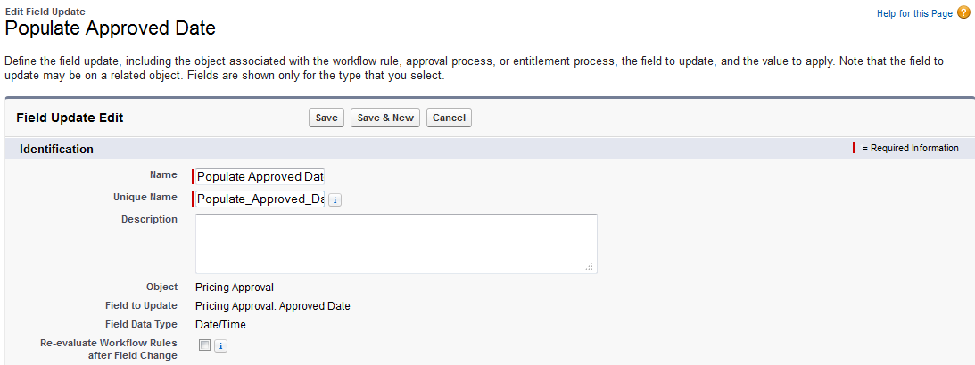
Approval Process Field Update
– Re evaluation
When a new Field update action is associated to the Approval Process Steps, you can enable all the work flows to be re-evaluated as a result of that field update

Slide 30
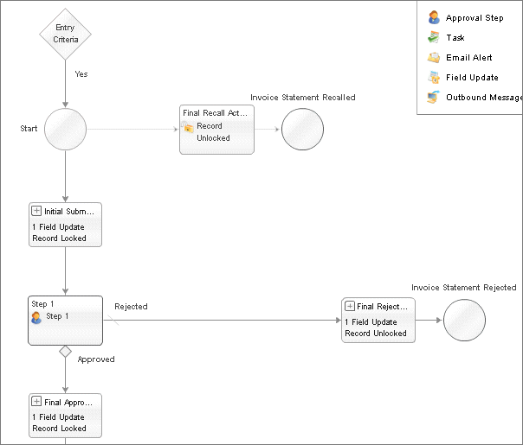
Approval Process Visualizer UI
Click View Diagram from the approval process detail page
An approval process visualizer opens in new window
It gives pictorial representation of approval phase
Notes:
Visualizer UI: is a flow chart representation of all the steps that you have associated or defined as a part of the workflow.

Slide 31
Approval Process Facts
A name and description to distinguish it from other approval processes
The Unique Name field can contain only underscores and alphanumeric characters. It must be unique within the selected object type, begin with a letter, not include spaces, not end with an underscore, and not contain two consecutive underscores
Entry criteria if you only want records with certain attributes to be included
Settings to specify who, if anyone, can change a record once it has been submitted for approval
Any number of steps that determine the sequence of actions to take when a record matches the criteria. Each step can have up to 40 actions, 10 of each type: email alerts, field updates, tasks, and outbound messages.
Notes:
Visualizer UI: is a flow chart representation of all the steps that you have associated or defined as a part of the workflow.

Slide 32
Approval Process Checklist:
Prepare an approval request email template.
Prepare an approval request post template. (chatter post)
Determine the approval request sender.
Determine the assigned approver. (default approver)
Determine the delegated approver.
Decide if approval process needs a filter.
Design initial submission actions.
Decide if user can approve request from a wireless device.
Determine if user can edit records that are awaiting approval.
Determine if records should be auto-approved or rejected.
Determine the approval levels\phases.
Determine the action when the approval request is approved or rejected.

Slide 33
Business Scenario:
Let’s take PTO process as an example
When a practitioner applied for an PTO, it goes to Reporting Manager. Reporting Manager reads the information such as number of days, reason, etc
Reporting Manager will also consider assignment allocated to the respective practitioner, timeline & the impact on the deliverables
Based on the above information, the manager will decide. So, the manager here considers benefits for both employer & employee without impact on business
Let’s bring in salesforce here
In Salesforce, PTO is an object. Practitioner creates a PTO record to initiate a PTO request. The record will contain information about the leave request
The PTO record will be submitted for approval & notifies the approver (Reporting Manager)
Reporting Manager take appropriate decision. Based on the decision took, the status of the PTO record will be updated & notifies the requestor (Practitioner)

Slide 34
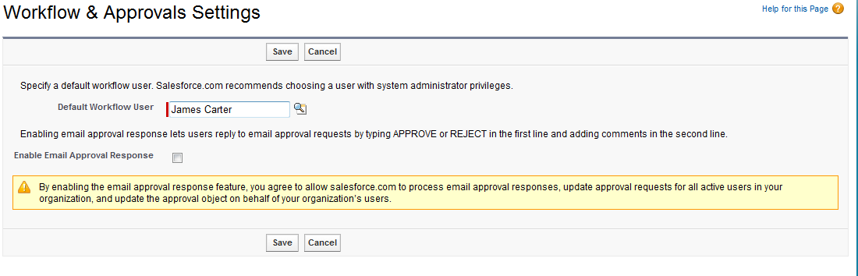
Workflow & Approvals setting
Click Your Name > Setup > Create > Workflow & Approvals | Settings
Select a Default Workflow User that you want Salesforce to display with a workflow rule when the user that triggered the rule is not active.
To enable email approval response for your organization, select the Enable Email Approval Response checkbox.

Slide 35
Best Practices
Before deleting a Email alert, check if any workflow rules or approval processes are using it
Avoid associating more than one field update with a rule or approval process that applies different values to the same field
To monitor pending time-dependent actions and cancel them if necessary, click Setup > Monitoring > Time-based Workflow
Before defining field update, check the type of the field you want to update. Read-only fields like formula or auto-number fields are not available for field updates
Use Debug log or System Log to check whether workflow conditions are met and designated actions are invoked

Slide 36
Debugging Tools

Slide 37
Auditing Tools
Force.com platform provides three main mechanisms for debugging errors. These are also known as Auditing tools:-
  Field history allows developers to track changes to field values of up to 20 fields for any object.
  Debug Logs is a persistent store in which logs are stored for transactions performed by up to 20 users.
  System Logs allows developers to run apex commands and view the logs
  Setup Audit trail allows developers to view all configuration changes (example creation of object, changing field type, creating a workflow etc.) made in last 180 days.

Slide 38
Setup Audit Trail
Setup Audit Trail of Salesforce is used to track configuration changes made. The system audit trail changes provides the date of change, description of the change, user who made the change. Twenty most recent changes are displayed in the audit trail. Last 180 days changes can be exported into a csv file. View Setup Audit Trail feature is available via the Security Control menu.
Examples of configuration changes are creation of object, adding a new field, changing field type or setting up a new approval process.

Slide 39
Field History Tracking
Field history tracking can be enabled at object level at the time of creation of objects. Up to 20 fields can be tracked for one object. As an example, any changes in field values are stored as part of Field history tracking. During Field history tracking, Time of change, user who made the change, prior value and new values are stored.
Field history cannot be tracked for data types such as Multiselect Picklist, Text Area (Long)
In the Custom Fields and Relationship area of Object configuration, "Set History Tracking", is used to enable field level tracking. Review History related list can then be added to page layout to view changes to fields.

Slide 40
System Log
There is a link to System Log(now known as Developer Console) at the upper right corner of the page.
System Log allows developers to enter Apex code and see the results of running this code. System Log display information about workflow rules, validation rules, debugging information and resource utilization.

Slide 41
Debug Log
Debug log is an organization-wide persistent log. It can store debug log for transactions performed by specific users.
Logs for up to 20 users can be persisted. Debug Log is available via the Monitoring menu.

Slide 42
Thank You

